Slide 1
Association of Directors of Social Services (ADSS) Cymru Assessing the readiness of Social Services departments to implement Copilot into Adult Social Care Champions Network 11th December 2024

Slide 2
Agenda
Introductions
Project Overview & Scope
Introduction to Copilot / demonstration
Champions Network
Scope of Activities
Champions Responsibilities
Any changes to the Terms of Reference
Engagement Plan - Assessing “workforce readiness”
Next Steps

Slide 3
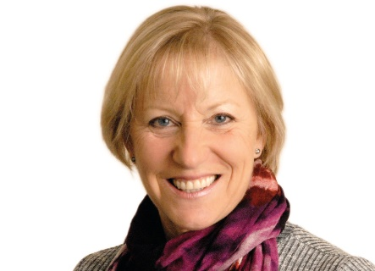
Introductions – Project Team
Nicki Harrison, Project Manager – ADSSC
Glenda George, Workforce Lead – ADSSC
Hannah Thomas, Workforce Project Member – ADSSC
Tina Mathias, Workforce Project Support – ADSSC
Matt Munslow, Chief Learning Officer, Stable

Slide 4
Section 2 Project Overview and Scope

Slide 5
Assessing the workforce readiness of Social Services departments to implement Copilot into Adult Social Care
Scope of the Project
To assess the workforce readiness of Social Services Teams of 22 local authorities in Wales to implement Microsoft Copilot to support the delivery of statutory care assessment and care management processes within Adult Social Work Teams. Therefore, this project will focus on three functions:
Information, advice and assistance provided through a first point of contact
The assessment of need for care and support
The review of the assessment

Slide 6
Assessing the readiness of Social Services departments to implement Copilot into Adult Social Care
Outputs / outcome of the Project
By 31st March 2025:
National report that will highlight the:
Digital Readiness
Workforce Readiness
Report will provide high level recommendations regarding next steps
Specific Language Prompts that will support the speed, efficiency and impact of Copilot for Adult Social Services

Slide 7
Section 3 Introduction to Copilot / demonstration

Slide 8
Section 4 Champions Network

Slide 9
Change Champions
Passionate
Experienced
Creative
Motivated
Curious

Slide 10
Champions Network – Terms of Reference
Scope of activities
Workforce readiness
Change management and Communication
Development of Social Care – Specific Language Prompts
Feedback and reporting

Slide 11
Champions Network – Terms of Reference
Champions Responsibilities
Advocate for Workforce readiness
Assess and feedback on readiness
Facilitate local engagement
Identify training and development requirements if implemented
Contribute to the creation of language prompts

Slide 12
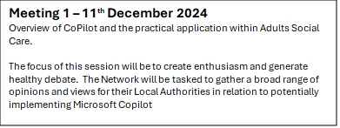
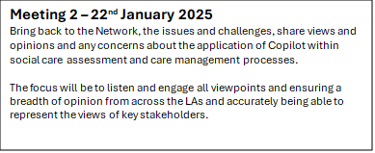
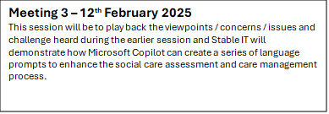
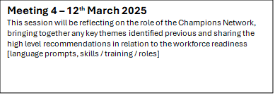
Champions Network Framework

Slide 13
Section 5 Engagement Plan for assessing workforce readiness

Slide 14
Assessing the workforce readiness
Key themes:
Awareness & understanding of digital tools
Attitudes and behaviours
Implementing change & perceived challenges
Training needs
Capacity / resources
Ethical considerations
Corporate Policies
Processes / workflow – development of language prompts

Slide 15
How we will do this
Champions Network
When | Key Focus | Action / Outcomes
Wednesday 11th December | The focus of this session will be to create enthusiasm and generate healthy debate. The Network will be tasked to gather a broad range of opinions and views for their Local Authorities in relation to potentially implementing Microsoft Copilot | Briefing Pack which will include link to the survey :- Awareness and understanding of digital tools Attitude / behaviours Implementing Change & perceived challenges Training Needs Recruit practitioners to attend the Focus Group in January
Wednesday 22nd January | Bring back to the Network, the issues and challenges, share views and opinions and any concerns about the application of Copilot within social care assessment and care management processes. The focus will be to listen and engage all viewpoints and ensuring a breadth of opinion from across the LAs and accurately being able to represent the views of key stakeholders. | Key themes emerging from Local Authorities / Survey Initially feedback from the Focus Groups & Semi Structured Interviews
Wednesday 12th February | This session will be to play back the viewpoints / concerns / issues and challenge heard during the earlier session and Stable IT will demonstrate how Microsoft Copilot can create a series of language prompts to enhance the social care assessment and care management process. | Feedback from: Focus Groups and update on the development of the language prompts Semi Structed Interviews
Wednesday 12th March | This session will be reflecting on the role of the Champions Network, bringing together any key themes identified previous and sharing the high level recommendations in relation to the workforce readiness [language prompts, skills / training / roles] | Bringing together key themes and sharing high level recommendations

Slide 16
How we will do this [amended version – 18th December]
Focus Groups with practitioners / front line staff
When | Key Focus | Key areas covered:
Session 1 – 13th Jan 2:30pm – 3:30pm Session 2 - 17th Jan at 1.30pm – 2.30pm | Focus Group 1 - First point of Contact [Ideally 2 practitioners per Focus Group] Session 1 - Active listening to the views of practitioners with roles as the first point of contact, considering the practicalities of using Copilot on a day-to-day basis. Session 2 - Feedback Session – How Copilot can help you | Processes / workflow / systems Development of Language Prompts
Session 1 – 14th Jan 12:00 – 1:00 pm Session 2 - 20th Jan at 12 – 1:00 pm | Focus Group 2 - Carrying out statutory assessment [Ideally 2 practitioners per Focus Group] Session 1 - Active listening to the views of practitioners undertaking assessments for care and support and an exploration of how Copilot could assist in this process. Session 2 - Feedback Session – How Copilot can help you | Outcomes: Specific Language Prompts that will support the speed, efficiency and impact of Copilot for Adult Social Services A clear understanding of how copilot could potentially help reduce the administrative pressures
Session 1 – 14th Jan 1:30pm – 2:30pm Session 2 - 20th Jan at 1.15pm – 2.15pm | Focus Group 3 - Review of statutory assessment [Ideally 2 practitioners per Focus Group] Session 1 - Active listening to the views of practitioners involved in reviewing assessments and an exploration of how Copilot could meaningfully assist in this process, Session 2 - Feedback Session – How Copilot can help you

Slide 17
How we will do this
Semi Structured interviews with Local Authorities
When: | Key areas covered: | Target Audience with Local Authority
December 2024 / January 2025 | Attitude / Behaviours Implementing Change Capacity / resources Corporate Policies | Nominated Contact Officer – Workforce Nominated Contact Officer – Digital

Slide 18
Assessing the “workforce readiness”
Co-producing the Local Authority Briefing pack and engagement tool for:
Agreeing themes
Agreeing questions within the survey
What have we missed / Where are the gaps

Slide 19
Assessing the “workforce readiness” https://app.sli.do/event/8GuZnYkEKJfC39W8DTBwJB

Slide 20
Section 6 Next Steps

Slide 21
Assessing the “workforce readiness”
Next steps:
Project team will finalise briefing pack / engagement tool – by Friday 13th December. This will be in both English and Welsh
Project team will ensure resources on the ADSS landing page Copilot
Change Champions to engage, gather views and comments with their local authorities – sharing the briefing pack / attend various meetings etc.
Change Champions to recruit / identify practitioners and frontline staff for the focus groups – inform workforce@adss.cymru by Tuesday 7th January 2025
Project Team will develop comms in relation to the Focus Groups and circulate to Change Champions and Nominated Contact Officers
Project Team will set up and carry out the Semi Structured Interviews with Local Authorities

Slide 22
Questions & Answers

Slide 23
Contact Details workforce@adss.cymru

Slide 24
Thank you for listening and for contributing today

